Slide 1
Amazon Sales and Revenue Analysis
Rashmi Dubey

Slide 2
Content
About the Project
About the Data
Data Transformation and EDA
Visual Analytics and Key Insights
Dashboards

Slide 3

About the project
Sales management has gained importance to meet increasing competition and the need for improved methods of distribution to reduce cost and to increase profits. The objective of this project is to perform data analysis and visualisation and built dashboards to provide insights that can help in making data driven decisions to increase sales and revenue of the company.

Slide 4
About the data
The dataset is about the sales of electronic products from amazon platform in year 2019. Data is divided into 12 csv files and each file holds data for one month. The final dataset has following attributes :
Order ID : Unique Order ID number per Order
Product : Name of ordered Product
Quantity Ordered : Number of Items Ordered
Price Each : Price of one item (in $)
Order Date : Date when order was placed
City : City from where order was placed
State : State from where order was placed
Category : Category of the ordered Product

Slide 5
Data Transformation and EDA
Handling
Handling Null values :
There are some rows which are having only null values, so dropping those rows from the dataset.
Deriving
Deriving Columns :
City and State columns were derived from Purchase Address column.
Category column was created based on the name of the Product in Product Column

Slide 6
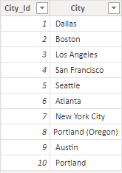
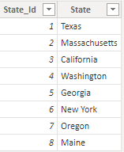
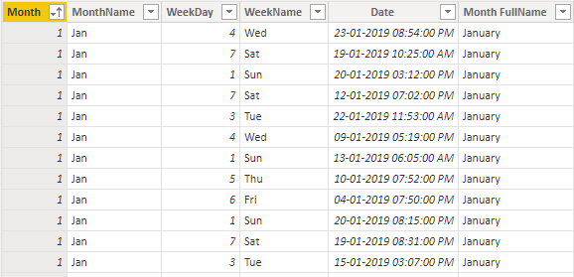
3.Removing Unnecessary Columns :
After extracting City and State columns from Purchase Address Column, dropping the column from the dataset.
Creating Tables using M Language :
We have to create Cities, States and Dates Tables using Column from dataset for data modelling.
Cities Table
States Table
Dates Table

Slide 7
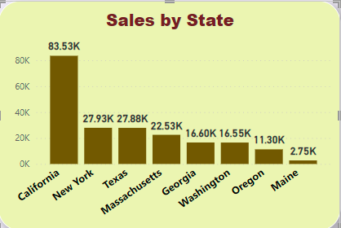
Visual Analytics and Key Insights
From total sales of 209K products, 83.53K products were sold in California state which is 40% of total sales.

Slide 8
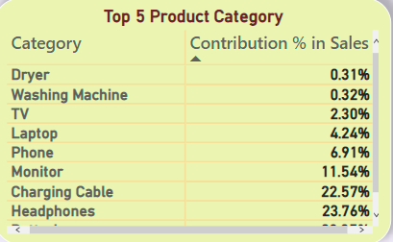
Batteries, Headphones and Charging Cables are most frequently ordered product categories.

Slide 9
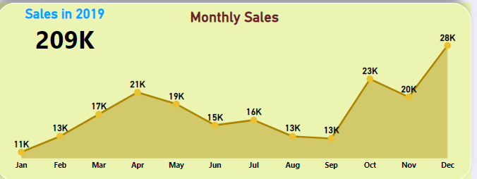
4th Quarter was best Quarter in terms of sales with 71K items sold whereas 1st and 3rd Quarters were worst and just sold 82K items combined.

Slide 10
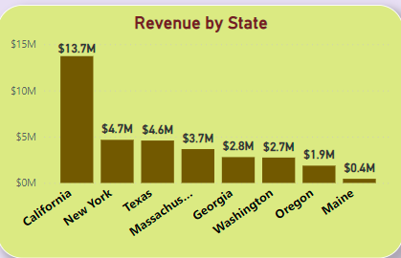
California state is biggest market which generates revenue of $13.7M which is 40% of total revenue.

Slide 11
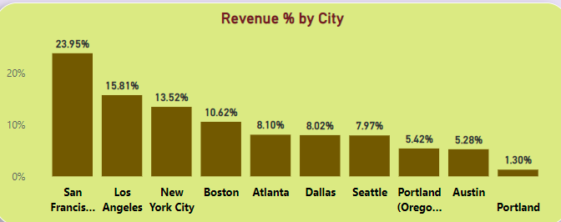
San Francisco, Los Angeles and New York City are top 3 cities which generates $18.5M revenue which is 54% of total revenue of $34.5M.

Slide 12
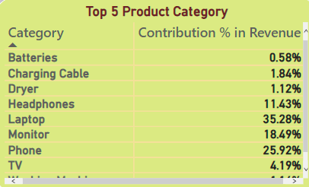
Laptop, Phone and Monitor are top 3 revenue generating Product Categories and generates $27.6M revenue which is almost 80% of total revenue.

Slide 13
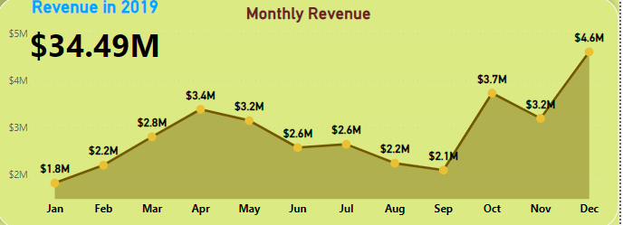
January, February, August and September are months which generates least revenue and too much below the average monthly revenue of $2.9M.

Slide 14
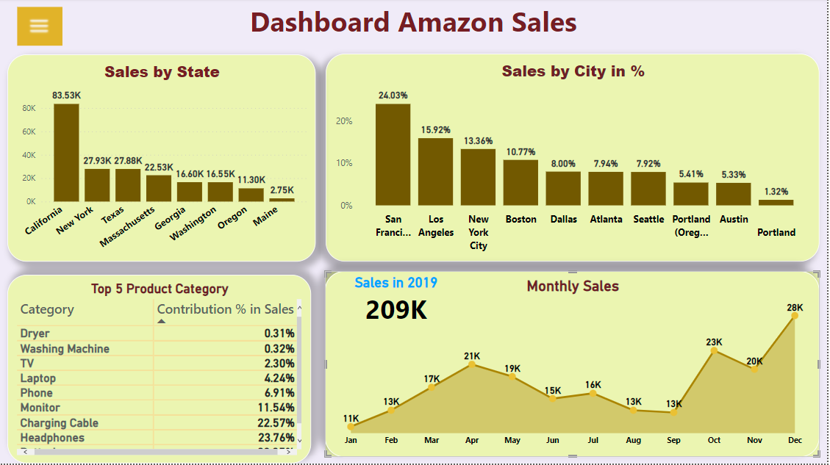
Dashboards

Slide 15
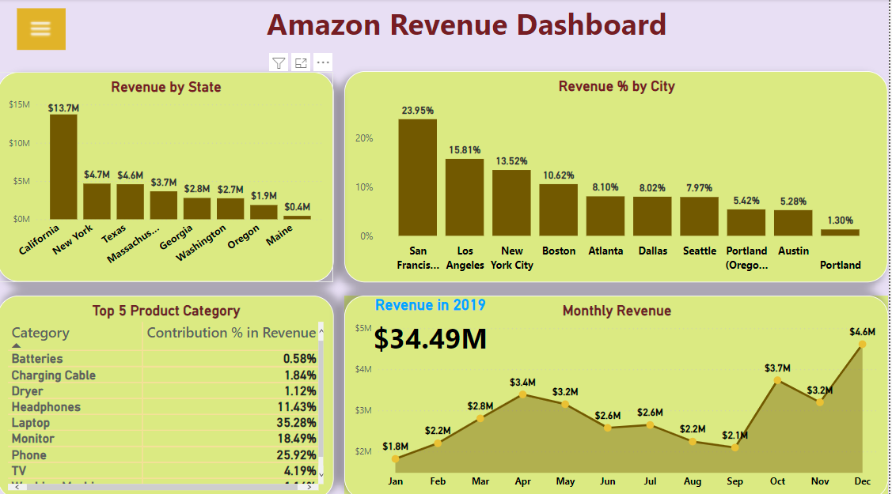

Slide 16

Thank You

